Slide 1
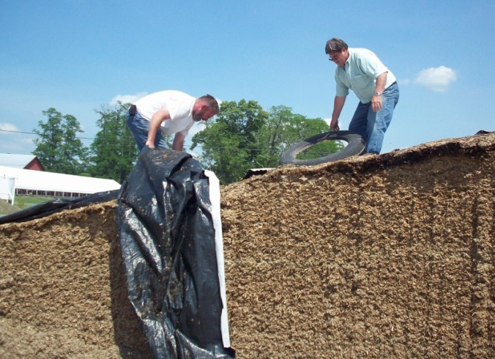
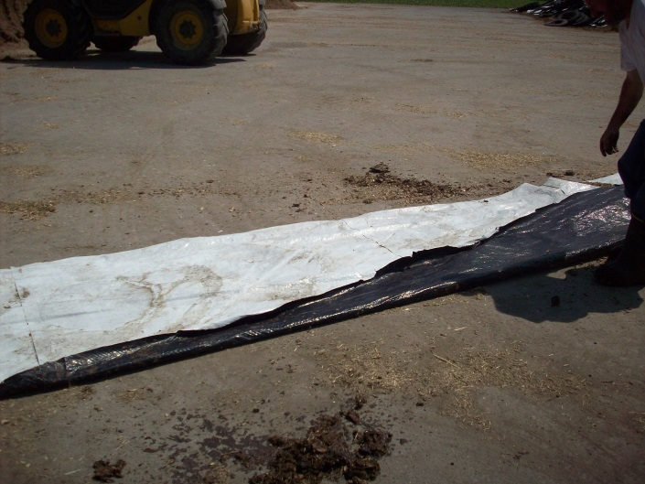
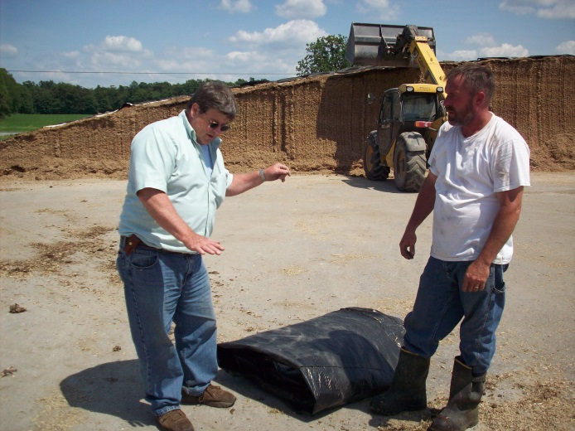
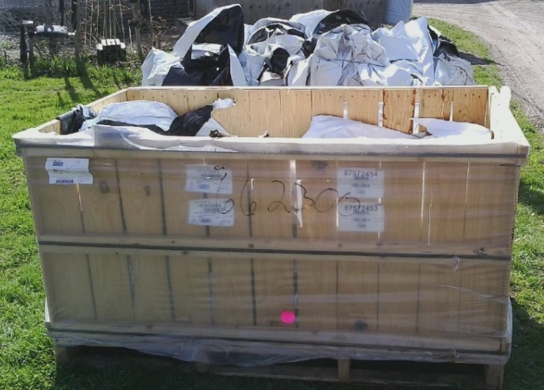
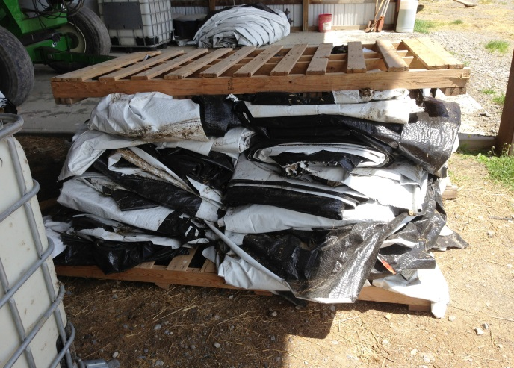
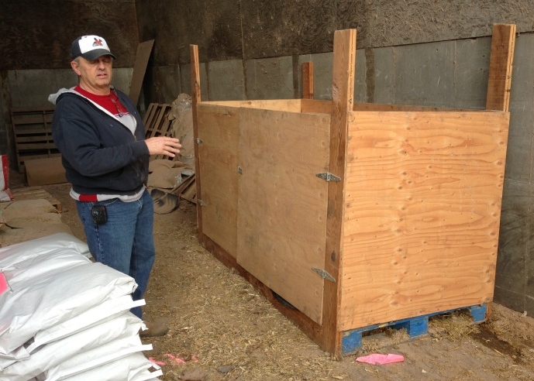
Recycling Agricultural Plastics Program
Best Management Practices
Preparing Bunker Covers and Silage Bags for Recycling
“It’s become routine to prepare plastic for recycling and there’s no plastic
blowing around the fields anymore.”
1. Cutting
Cut a 3-10’ width of bunker cover off of feed, staying safely back from the edge of the feed face. Drop on clean floor of the bunker.
Silage Bags
1. Cut 3-10’ pieces off the above ground portion of the bag.
2. Prepare plastic immediately. If it hits the ground, it gets dirty.
3. Fold into pieces that fit on a pallet.
4. Store on pallets or in crates with weights (to compress) on top.
2. Folding
Cross-cut in pieces not exceeding 25-30’ in length. Smaller pieces are easier to handle. Shake off loose feed; leave to “wind dry” if conditions are favorable. Fold lengthwise before folding into pieces that fit on a pallet.
3. Storing
Store on pallets or in crates with weights (to compress) on top. Or use any storage that keeps plastic clean and dry.
Additional Notes:
♦ Grit and gravel are the enemy; stains and smears from feed or soil are fine.
♦ Discard any significantly dirty plastic (or dry and brush dirt and feed off).
♦ Store the plastic under cover to keep it dry and clean, especially during the winter.
♦ If bundles of plastic are tied with twine, the twine needs to be removed prior to baling.
Bunker covers with reinforcement should be baled by itself as there are limited markets.
Bunker covers with separate oxygen limiting barriers may be baled together.
Cornell Waste Management Institute • cwmi.css.cornell.edu
Recycling Agricultural Plastics Program (RAPP) • recycleagplastics.css.cals.cornell.edu
Funding provided from the NYS Environmental Protection Fund
Cornell University is an equal opportunity, affirmative action educator and employer. ©2014 Cornell University

